Slide 1
Enocean Switch Demo
Configuration Guideline

Slide 2
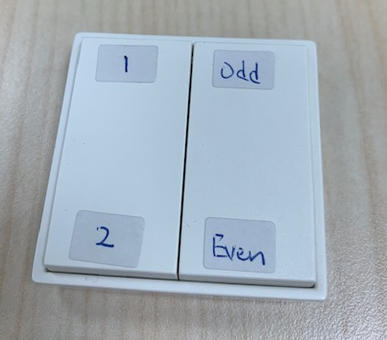
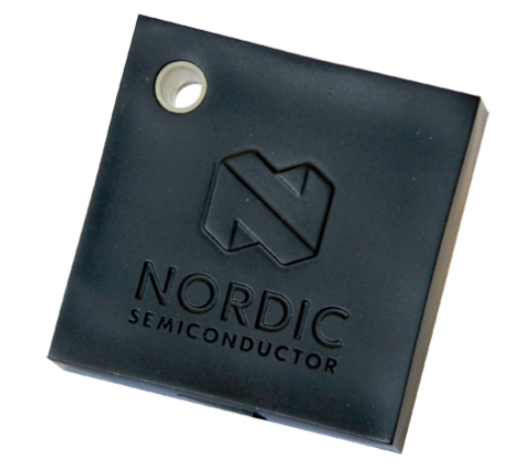
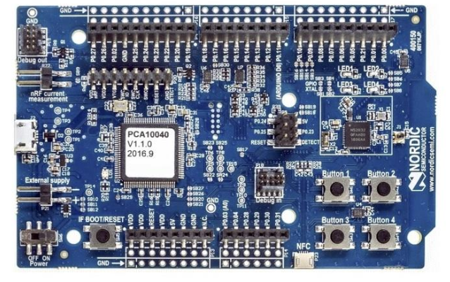
#1
Server
#3
Client / Enocean sniffer
#2
#4

Slide 3
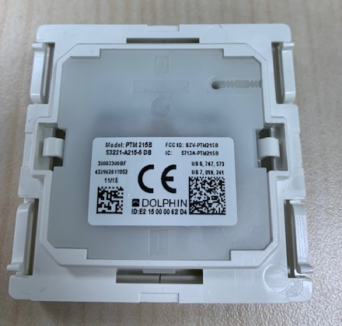
EnOcean Switch
Check the MAC address
e.g. 0xE2 15 00 00 62 D4
#define ENOCEAN_ADDRESS {0xD4, 0x62, 0x00, 0x00, 0x15, 0xe2};

Slide 4
Thingy FW
MESH SDK 3.1
Nordic SDK 15.2.0
All the thingy act as the server with provisioning.
Zip package: Server_thingy.7z
nrf5SDKforMeshv310src\examples\light_switch\server_thingy

Slide 5
Mesh Dongle
NRF52840 USB dongle
Two pre-compile HEX
light_controller_s140.hex
light_server_s140.hex
nrf5SDKforMeshv310src\examples\simple_demo

Slide 6
NRF52832 / NRF52840 DK
Use for the provision with nRF Mesh / Enocean Sniffer
Zip package : client_enocean.7z
MESH SDK version : 3.1.0
nrf5SDKforMeshv310src\examples\light_switch\client_enocean
#define ENOCEAN_ADDRESS {0xD4, 0x62, 0x00, 0x00, 0x15, 0xe2};

Slide 7
Provision
Thingy | Public Address | Group Address
#1 | 0001 | C001
#2 | 0002 | C002
#3 | 0003 | C001
#4 | 0004 | C002

Slide 8
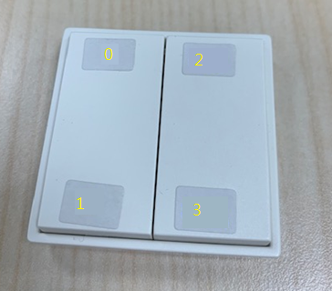
Press 0 – turn on thingy #1, #3
Press 1 – turn off thingy #1, #3
Press 2 – turn off thingy #2, #4
Press 3 – turn on thingy #2, #4
Press 0 – turn on thingy #1, #3
Press 1 – turn off thingy #1, #3
Press 2 – turn on thingy #2, #4
Press 3 – turn off thingy #2, #4

